Slide 1
Programmable Dataplane using P4 Language
Ramanand Shankarling
Rakesh Musalay
Naga Ganesh Kurapati

Slide 2
Introduction
P4 - Programming Protocol-Independent Packet Processors
3 major aspects
Target independence
Protocol independence
Reconfigurability

Slide 3
Key components
Headers
describe sequence and structure of a series of fields.
Parsers
specify how to identify headers and valid header sequences within packets.
Tables
perform packet processing using fields for match.
Actions
support for construction of complex actions from simpler protocol-independent primitives.
Control programs
determine the order of match + action tables that are applied to a packet.

Slide 4
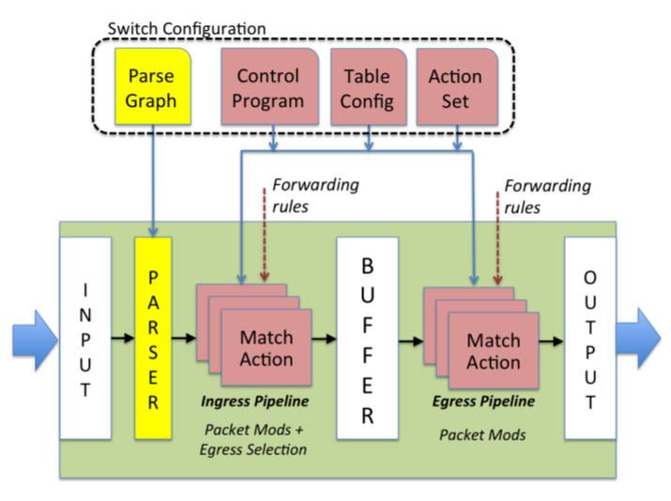
Abstract forwarding model

Slide 5
Project Idea
Design packet encapsulate/de-capsulate modules that can process packet headers and perform the following tasks applications and controllers
Identify video streams from/to a streaming server
Identify YouTube streams
Identify OpenSSL flows
Record and report statistics regarding the above flows

Slide 6
Tools and programs
Mist streaming server
Open-source multimedia streaming server
Supported formats and protocols : HLS, HDS, Smooth Streaming, RTMP, RTSP, MP3, FLV
Works on multiple platforms and provides web interface for configuration management

Slide 7
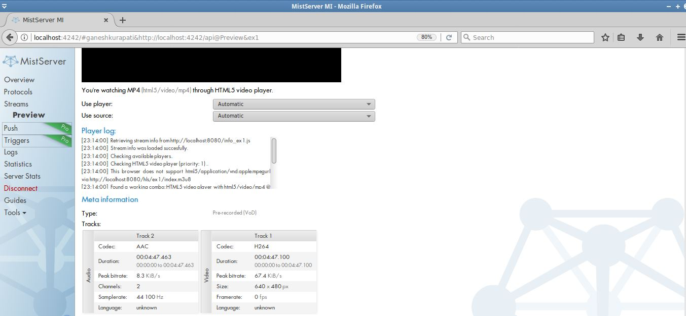
Mist server web interface
Sub Heading
Some Text

Slide 8
TCP REPLAY
TCP REWRITE
Provides packet editing functionality for pcap files
Rewriting Source & Destination MAC addresses
tcprewrite --enet-dmac=mac1 --enet-smac=mac2 -- infile=input.pcap --outfile=output.pcap
Modify Source and destination IP Addresses
tcprewrite --endpoints=ipv4-1:ipv4-2 --cachefile=example.cache -- infile=example.pcap --outfile=new.pcap

Slide 9
SCAPY
Forge or decode packets of a wide number of protocols, send them on the wire, capture them, match requests and replies
Replay modified packets and send them to the switch s1
Packets are sent using the command
sendp(rdpcap("/tmp/pcapfile"))

Slide 10

Environment setup
SWITCH S1
P4 Switch S1
S1
H1
10.0.0.1
10.0.0.2
H1
H2
Mist controller
Wire shark
Scapy
VLC player

Slide 11
DEMO

Slide 12
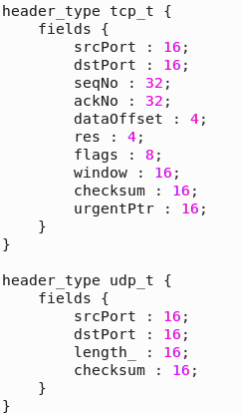
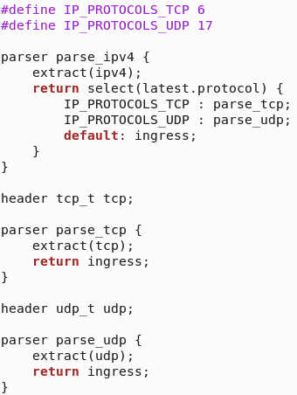
P4 Program
headers.p4 and parser.p4

Slide 13
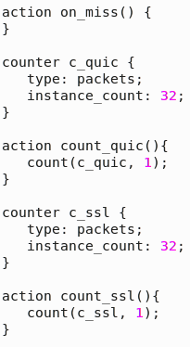
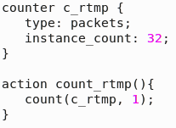
P4 Program
Counters

Slide 14
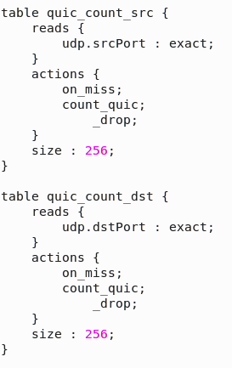
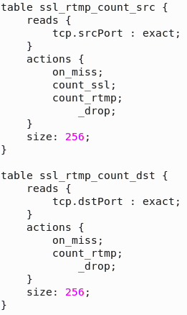
P4 Program
Tables

Slide 15
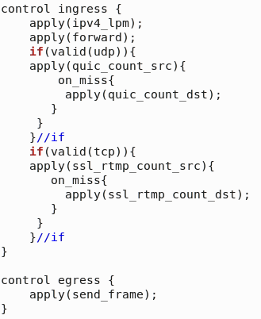
P4 Program
ingress and egress

Slide 16
Add or Delete Table Entries
Bash files

Slide 17
Conclusion
Successful implementation of program using P4 language to parse and identify specific type of packets, depending on which further actions can be defined.
Future work
The counter data to be fetched for traffic analysis and implement reporting.
Contextual routing.

Slide 18
References
https://en.wikipedia.org/wiki/P4_(programming_language)
P4: Programming Protocol-Independent Packet Processors - P. Bosshart, D. Daly, G. Gibb, M. Izzard, N. McKeown, J. Rexford, C. Schlesinger, D. Talayco, A. Vahdat, G. Varghese, D. Walker; CCR July 2014
http://p4.org/

